Slide 1


TESTING
Testing is not a process of finding bugs, it's a process of building confidence in the software.
- Michael Bolton

Slide 2

TESTING
Testing is the process of ensuring that the Java code is working as expected.
There are many different types of testing in Java, including unit testing, integration testing, and end-to-end testing.
Unit testing is the process of testing individual units of code, such as methods or classes.
Integration testing is the process of testing how different units of code work together.
End-to-end testing is the process of testing the entire application from start to finish.

Slide 3

TESTING FRAMEWORKS
Traditional Testing vs. Testing Frameworks
Traditional Testing:
Manual execution of test cases by developers or testers.
time-consuming and error-prone.
Limited scalability and repeatability.
Testing Frameworks:
Automated testing using specialized tools and frameworks.
Streamlined test case execution and result reporting.
Improved efficiency, scalability, and reliability of testing processes.
Most popular tools include JUnit, TestNG, and Selenium.
JUnit is a unit testing framework that provides a simple way to write and execute test cases.
JUnit has built-in features like Annotations, Test Runners, Test Suites, etc.

Slide 4
WRITING TEST CASES
Annotating test methods with @Test:
Use @Test to identify methods as test cases.
JUnit runs all methods annotated with @Test during test suite execution.
Tips for writing test cases:
Keep test cases small and focused, testing single units of functionality.
Utilize descriptive names for test methods to enhance readability.
Employ assertions to verify expected results.
Temporarily disable incomplete test cases using @Ignore when necessary.

Slide 5
ASSERTIONS
Assertions in Unit Testing:
Essential for verifying expected behavior in test cases.
Ensure code functions as intended, enhancing confidence in its correctness.
Important Assertions:
assertEquals: Verifies equality between expected and actual values. Example: assertEquals(1, 1);
assertArrayEquals: Ensures equality of expected and actual arrays. Example: assertArrayEquals(expectedArray, actualArray);
assertIterableEquals: Validates equality of expected and actual iterables. Example: assertIterableEquals(expectedList, actualList);
assertThrows: Confirms the occurrence of expected exceptions

Slide 6
ASSERTING EXCEPTIONS
Handling Expected Exceptions:
Utilize assertThrows() in JUnit to ensure expected exceptions are thrown during code execution.
Valuable for testing error handling scenarios and validating absence of unexpected exceptions.
Using assertThrows():
assertThrows() requires the expected exception class and the code block to execute.
Verifies that the specified exception is thrown during execution; otherwise, triggers an AssertionError.
Overview of Lambda Expressions with assertThrows():
In JUnit 5, employ lambda expressions to pass executable code to assertThrows().

Slide 7
JUNIT LIFECYCLE AND ANNOTATIONS
Test instances are created for each test method execution, ensuring isolation between tests and resetting the test environment before each run.
The test life cycle in JUnit manages setup, execution, and teardown of test environments through four annotations:
@BeforeAll:
Used to specify code that should be executed once, before all test methods in a test class. Useful for initializing shared resources
@AfterAll:
Used to specify code that should be executed once, after all test methods in a test class. Useful for cleaning up shared resources.
@BeforeEach:
Used to specify code that should be executed before each test method. Useful for setting up the test environment for each test case.
@AfterEach:
Used to specify code that should be executed after each test method. This is useful for cleaning up the test environment after each test case.

Slide 8
USING TAGS IN JUNIT
@DisplayName: Provides a custom name for test methods or test classes, improving readability of test reports.
@Disabled: Temporarily disables a test method or test class, excluding it from test execution.
@Tag: Allows grouping of tests based on specific tags with relevant keywords or categories.
Enhancing Readability: Custom display names clarify the purpose of tests, making reports more understandable.
Controlling Test Execution: Disabling tests selectively excludes them from execution, useful for skipping incomplete or irrelevant tests.
Tests can be grouped and filtered based on tags, aiding in selective test execution and management.

Slide 9
ASSERTALL
Allows grouping multiple assertions within a single test case.
Ensures all assertions are executed even if some fail, providing a comprehensive view of test results.
Lambda Expressions: Used to define multiple assertions within the assertAll block.
Even if one assertion fails, assertAll ensures remaining assertions are still evaluated.
Improves code readability and reduces duplication by consolidating related assertions.

Slide 10
NESTED CLASSES - JUNIT
Nested classes allow hierarchical structuring of test cases
Organize tests that share common functionality or context
Facilitates easier management and modification of tests
Enhances code comprehension by grouping tests with similar functionality

Slide 11

MOCKITO - MOCK DEPENDENCIES
Mockito is a popular open-source mocking framework for Java.
Facilitates mocking of dependencies, enabling isolated unit testing.
Mocking is crucial in unit testing to isolate components and focus on testing individual units without relying on real dependencies.
Mockito simplifies dependency management by providing mechanisms to create mock objects for testing.

Slide 12
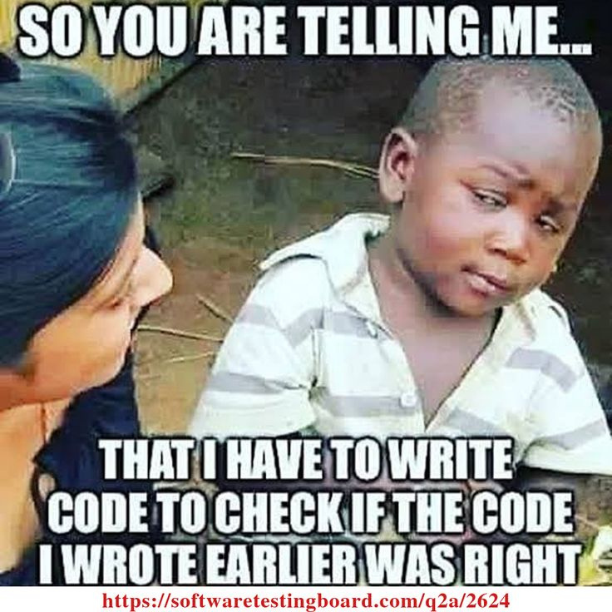
THANK YOU

